Slide 1
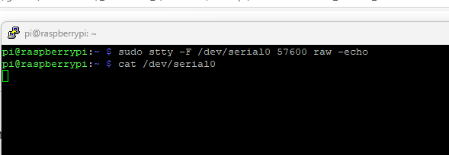
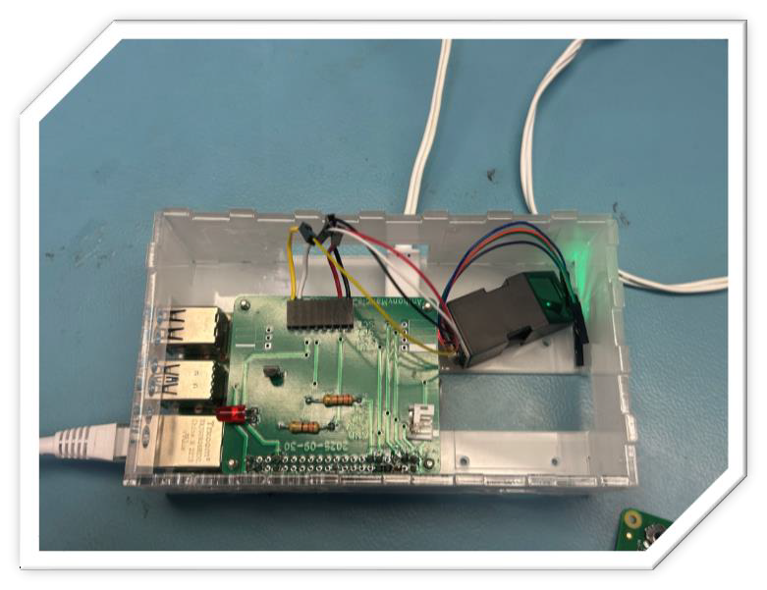
Sensor: Finger Print Reader (4690)
Anthony Mancia n01643670
Could not use i2c detect because my sensor uses UART

